Slide 1
Unit III

Slide 2
Syllabus
De Morgan’s Theorem, Adders, Multiplier – Unsigned, Signed, Fast, Carry Save Addition of summands; Division–Restoring and Non-Restoring; IEEE 754 Floating point numbers and operations.

Slide 3
De Morgan’s Theorem
It is a very powerful tool used in digital design
De Morgan’s theorem are used to solve the expressions of Boolean Algebra.
It gives relation between union, complement and intersection in set theory.
The theorem explains that the complement of the product of all the
terms is equal to the sum of the complement of each term.
Likewise, the complement of the sum of all the terms is equal to the product of the complement of each term.
There are 2 laws: first De Morgan’s law and Second De Morgan’s law.

Slide 4

Two Theorems
Theorem1
The left hand side (LHS) of this theorem represents a NAND gate with inputs A and B, whereas the right hand side (RHS) of the theorem represents an OR gate with inverted inputs.
This OR gate is called as Bubbled OR.

Slide 5
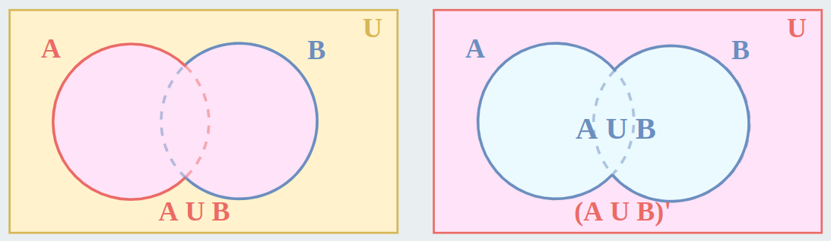
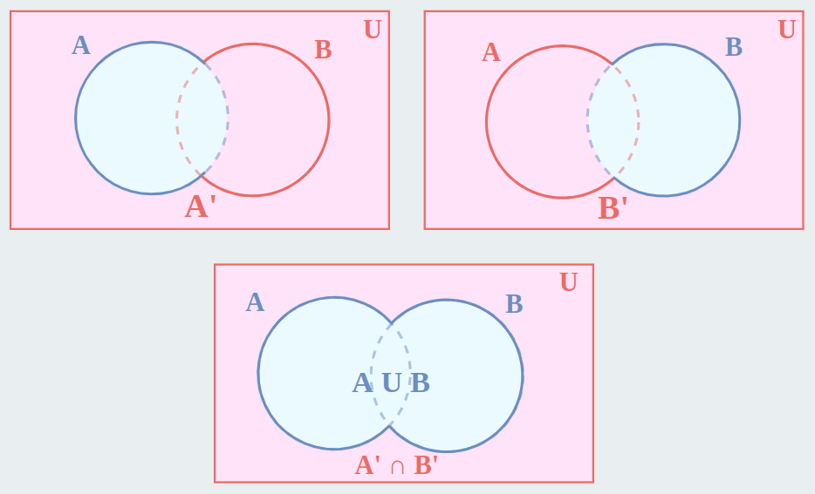
Venn diagram proof (First theorem)
(AUB)’
A’ + B’

Slide 6
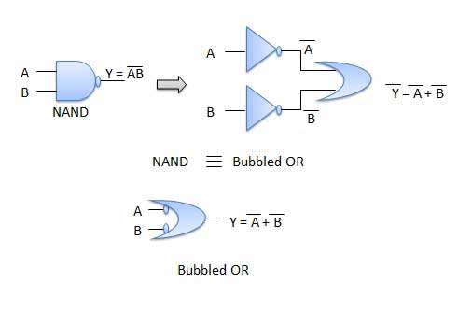
Theorem1 – Logic diagram

Slide 7
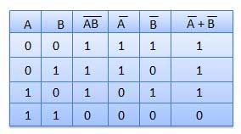
Table showing verification of the De Morgan's first theorem

Slide 8

Theorem 2
The LHS of this theorem represents a NOR gate with inputs A and B, whereas the RHS represents an AND gate with inverted inputs.
This AND gate is called as Bubbled AND.

Slide 9
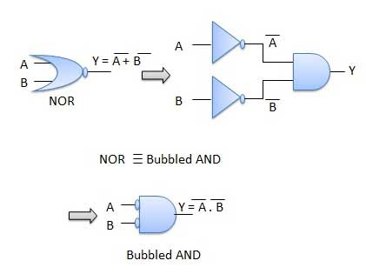
Theorem 2- Logic diagram

Slide 10
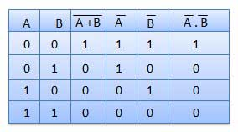
Table showing verification of the De Morgan's second theorem

Slide 11
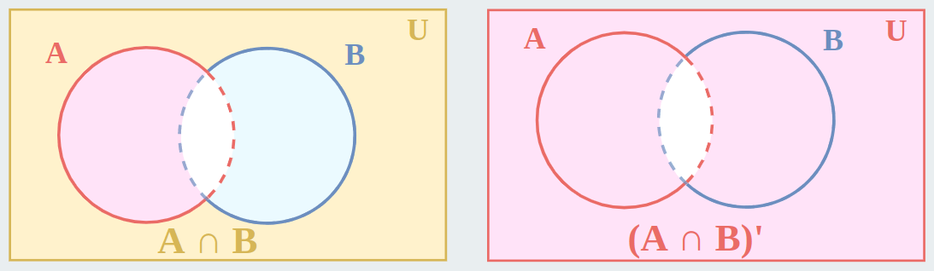
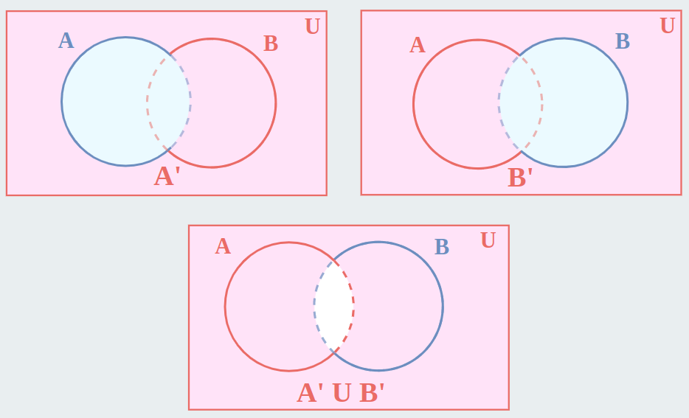
Theorem 2

Slide 12
Applications of De Morgan’s Theorem
In the domain of engineering, using De Morgan’s laws, Boolean expressions can be built easily only through one gate which is usually NAND or NOR gates. This results in hardware design at a cheaper cost.
Used in the verification of SAS code.
Implemented in computer and electrical engineering domain.
De Morgan’s laws are also employed in Java programming.

Slide 13
Arithmetic Logic Unit
ALU is the heart of any Central Processing Unit.
A simple ALU is constructed with Combinational circuits.
It is a digital circuit to do arithmetic operations like addition, subtraction, multiplication and division.
Logical operations such as OR, AND, NOR etc.
Data movement operations such as LOAD and STORE.
Complex ALUs are designed for executing Floating point, decimal operations and other complex numerical operations. These are called as Co-processor and work in tandem with the main processor.
The design specifications of ALU are derived from the Instruction set Architecture.
The ALU must have the capabilities to execute the instructions of ISA.
Modern CPUs have multiple ALU to improve the efficiency.

Slide 14
Arithmetic Logic Unit
ALU includes the following Configurations :
- Instruction Set Architecture
- Accumulator
- Stack
- Register – Register architecture
- Register – Stack architecture
- Register – memory architecture
The size of input quantities of ALU is referred as word length of a computer

Slide 15
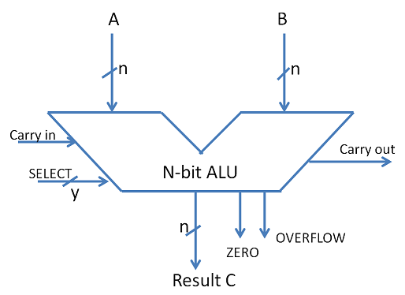
ALU Symbol

Slide 16
ADDERS
The basic building blocks of an ALU in digital computers are Adders.
Types of Basic Adders are
- Half Adder
- Full Adder
Parallel adders are nothing but cascade of full adders. The number of full adders used will depend on the number of bits in the binary digit which require to be added.
Ripple carry adders are used when the input sequence is large. It is used to add two n-bit binary numbers.
Carry look ahead adder is an improved version of Ripple carry adder.
It generates the carry-in of each full adder simultaneously without causing any delay.

Slide 17
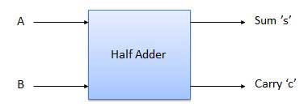
Half Adder
Half adder is a combinational logic circuit with two input and two output. The half adder circuit is designed to add two single bit binary number A and B. It is the basic building block for addition of two single bit numbers. This circuit has two outputs, carry and sum.

Slide 18
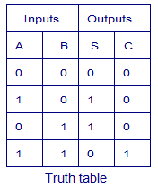

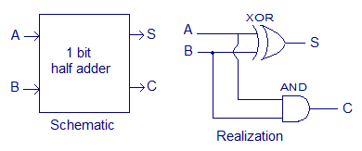
Truth Table and Circuit Diagram
Boolean Expression

Slide 19
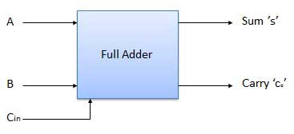
Full Adder
Full adder is developed to overcome the drawback of Half Adder circuit. It can add two one-bit numbers A and B, and carry c. The full adder is a three input and two output combinational circuit.

Slide 20
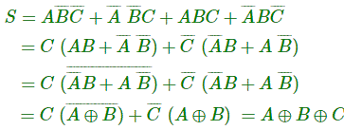

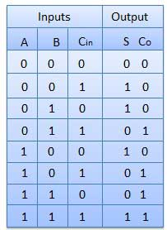
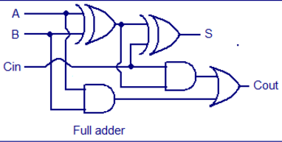
Truth Table and Circuit Diagram

